Slide 1
LATRODECTUS HASSELTI

Slide 2
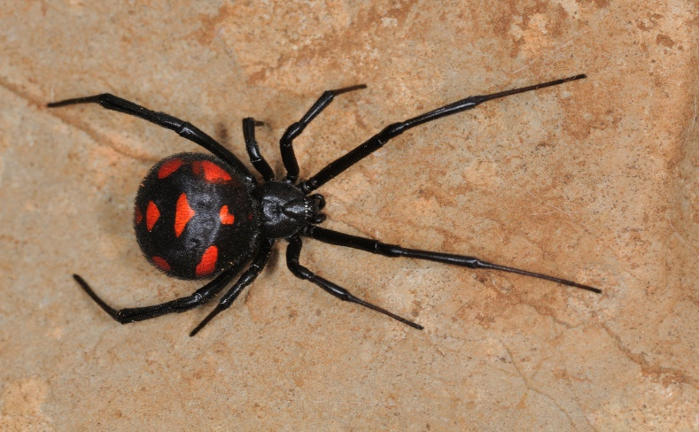

Slide 3
Class : Arachnida
Scientific name : Latrodectus hasselti
Family :Theridiidae
Kingdom : Animalia
Phylum : Arthropoda
Common name : redback spider, red-striped spider, red-spot spider,Kapara spider and the Kanna-jeri spider.

Slide 4
DISTRIBUTION
Originate in the South Australian or adjacent Western Australian deserts, but now found throughout Australia, SouthEast Asia and New Zealand
Found throughout Australia and are common in disturbed and urban areas.

Slide 5
PHYSICAL DESCRIPTION:
- Redback spiders are bilaterally symmetrical
- Cold-blooded.
FEMALE :
10 mm in length
body sizes as large as a pea
typically black with a red stripe, sometimes broken, on the dorsal surface of the upper abdomen and a red hourglass-shaped spot on the ventral side of the abdomen
young female redbacks have additional white markings on their abdomens that they lose as adults.

Slide 6
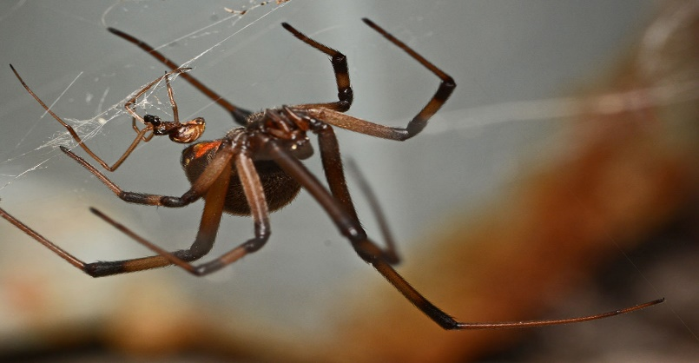
MALE :
3-4 mm in length.
male redbacks are typically light brown in color with a dorsal red stripe and a paler hourglass shape on the ventral side of the abdomen.

Slide 7
REPRODUCTION :
Redback spiders can mate anytime during the year but do so most commonly during summer months when temperatures are higher.
LIFESPAN :
Female redback spiders live for 2-3 years whereas males only live for about 6-7 months.

Slide 8
FOOD HABITS :
Redback spiders are insectivores that prey on small insects caught within their webs such as ants. They also sometimes catch larger animals stuck in their webs such as mice, small birds, snakes, small lizards, king crickets.

Slide 9
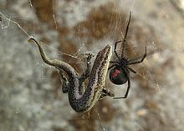

Slide 10
GENERAL SYMPTOMS
Lymphangitis and nervous twitchings, scarlet burning eruption.
Long lasting effects seem to indicate it as a "chronic" blood poisoning.
Arrests intense pain in pyaemia.
Great oedema in neighborhood of wound
Paralysis of limbs, with great wasting of muscles. violent, darting, burning pains preceding paralysis
Vertigo, tendency to fall forward, septicaemic conditions
Loss of memory
Roaring noises.

